Slide 1
The Statistical Question
Out of the five variables selected which variable is the most impactful predictor of life expectancy?
The Hypothesis
H_{o}: β₁ + β₂ + β₃ + β₄ + β₅ = 0
H_{a}: β₁ + β₂ + β₃ + β₄ + β₅ ≠ 0
Note: With the hypothesis this is only testing if at least one of the predictor variables is significant. As per the question, we will be looking at which is the most impactful in terms of β.

Slide 2
The Variables
Status: A binary categorical variable which denotes whether or not a country is considered a developed country, or developing country.
Alcohol: Alcohol, reported per capita consumption (in liters of pure alcohol).
HDI: Human Develop Index, in terms of income composition of resources.
Total Expenditure: Government expenditure on health as a percentage of total government expenditure.
GDP: GDP per capita in USD.
Life Expectancy: This is going to be our response variable and it is as it states. This is the average life expectancy in years.

Slide 3
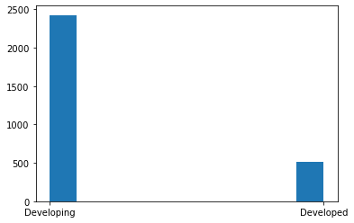
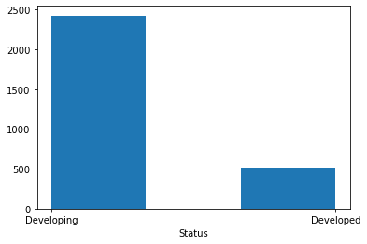
Histogram for Status
Of course there aren’t over 2500 countries in the world. This is counting each country multiple times since the data is across a period of 15 years. The actual count isn’t all too important but rather the comparison of how many countries are considered developing versus developed.

Slide 4
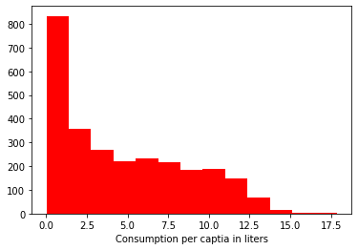
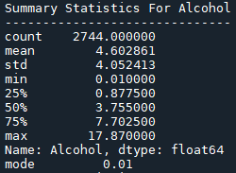
Histogram and Summary Statistics for Alcohol

Slide 5
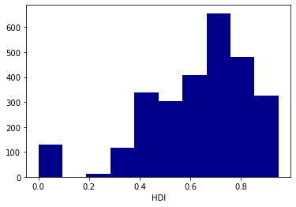
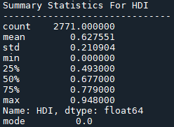
Histogram and Summary Statistics for HDI

Slide 6
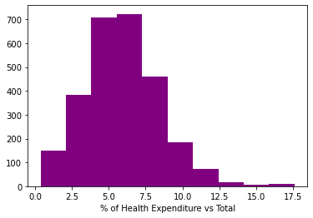
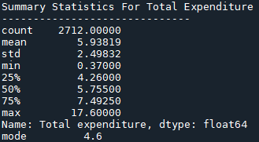
Histogram and Summary Statistics for Total Expenditure

Slide 7
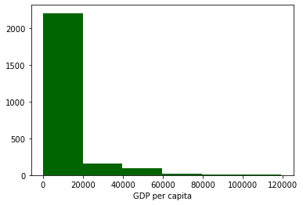
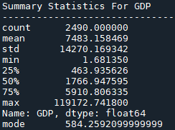
Histogram and Summary Statistics for GDP

Slide 8
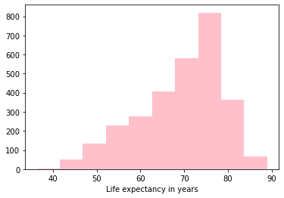
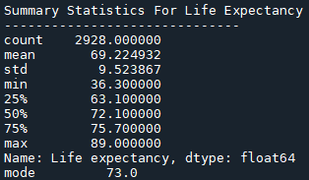
Histogram and Summary Statistics for Life Expectancy

Slide 9
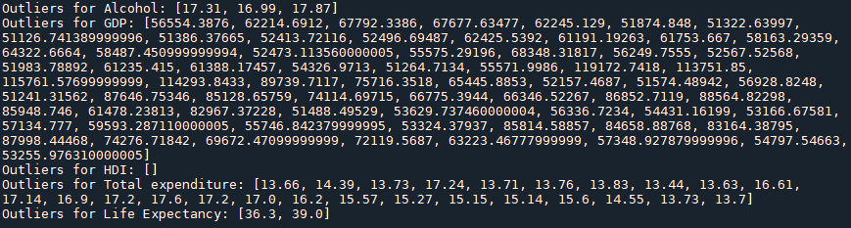
Summary of Outliers
The outliers as seen above are fairly expected. The outliers were selected using a z-score method. Any value above 3 standard deviations for each variable is listed above. I anticipated quite a few for GDP given the distribution of the histogram, and the distribution of Status as well. Also, from my general knowledge alone I know a lot of countries, if not the vast majority are pretty low on the GDP scale. Since the variable I am trying to predict is Life Expectancy I don’t plan on removing the outliers as of right now. I’m not sure if this is the proper course of action but given that Life Expectancy only has two outliers, both on the low end, I’m not sure that the outliers of the other variables would be impactful in this case in terms of generating a model, especially since they are occurring on the high end rather than the lower end. I’m not sure if this line of reasoning is sound but it’s seems to be correct.

Slide 10
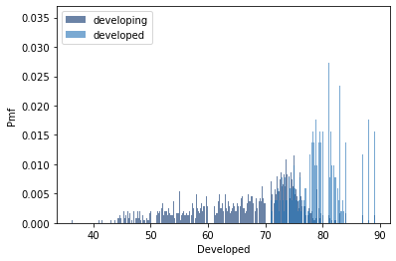
PMF of Life Expectancy between Developing and Developed Nations
Looking at the pmf it really isn’t all too surprising although I didn’t expect to see any developing countries in the high 80s. It’s clear though from the pmf that there is quite a stark difference between developed and developing nations.

Slide 11
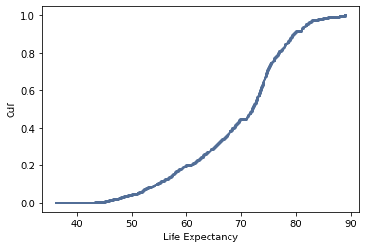
CDF of Life Expectancy
The cdf of Life Expectancy more or less looked like what I had anticipated as well. Given the information from the pmf, it seems that the overall distribution of life expectancy is actually fairly high, with only about 20% of the values being below 60 years. Also, the 50% mark being at about 75 years is fairly high given the maximum of 89.

Slide 12
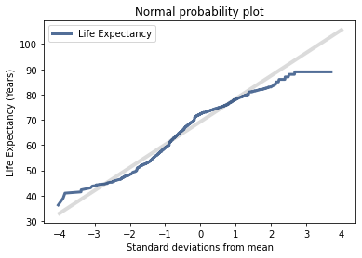
Normal Probability Plot of Life Expectancy
I wanted to check the normal distribution of life expectancy to check for normality and unfortunately I think this plot makes indicates that the data are not normally distributed, at least for this variable. I wanted confirmation for this after seeing the pmf. I will have to check the residuals of the model afterwards to confirm normality.

Slide 13
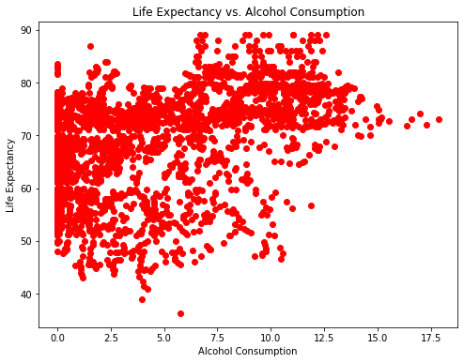
Scatter plot of Life Expectancy vs Alcohol Consumption
Unfortunately, this scatterplot indicates that this variable probably has an extremely weak relationship with life expectancy. I could run a correlation test to check but it is fairly clear from the plot that these variables have very little relation if any at all and I don’t think it will be a useful predictor.

Slide 14
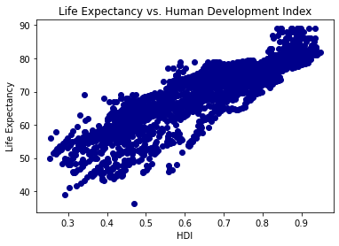
Scatter plot of Life Expectancy vs HDI
This is actually an awesome scatter plot because it demonstrates a fairly clear linear relationship between the two variables. I anticipate that this will be the most useful variable in the regression analysis.

Slide 15
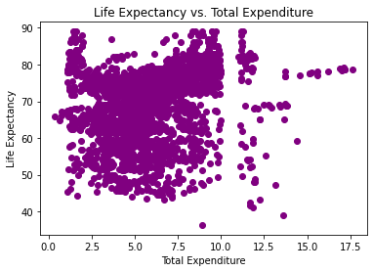
Scatter plot of Life Expectancy vs Total Expenditure
Unfortunately, this scatterplot also indicates a similar message as Alcohol Consumption. There really isn’t much of a relationship here at all.

Slide 16
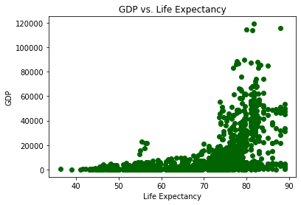
Scatter plot of GDP vs Life Expectancy
What is interesting about this scatterplot is that it suggests that GDP and Life Expectancy have an exponential relationship with one another. This means that if I perform a log transformation on GDP I should end up with a fairly linear relationship between the two. Also, I flipped the axes on this scatter plot because it was easy to see the relationship in this way.

Slide 17
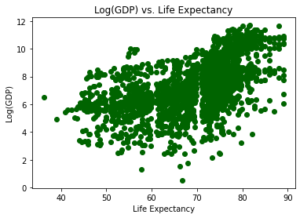
Scatter plot of Log(GDP) vs Life Expectancy
Bingo! With the transformation of taking the log of GDP, the relationship between Life Expectancy and Log(GDP) looks to be linear. I’m not sure how strong the relationship is, but I am interested to see how this variable will act as a predictor!

Slide 18
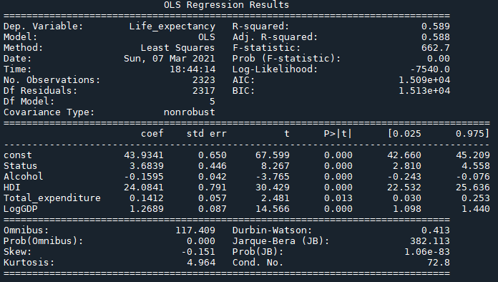
Linear Regression and the Hypothesis Test
Hypothesis Test Results:
Looking at the results for the hypothesis test given in the beginning of the PowerPoint, we can see that the p-value for the f-test-statistic is 0. Which tells us that we reject the null hypothesis and that at least one of the variables in the model is a significant predictor of Life Expectancy.

Slide 19
Conclusion
For the hypothesis test we ended up rejecting the null due to the p-value for the F-statistic which lead us to conclude that at least one of our predictors were significant.
Out of the variables that I had chosen the most impactful predictor of Life Expectancy was the Human Development Index. Not surprisingly, the “status” of the country was the next most impactful predictor.
One of the more surprising bits of the analysis was that alcohol and Total expenditure were not that impactful at all. I anticipated that this would be the case when we looked at the scatterplots but it was still surprising at the moment because I had thought for sure that both of these things would have had a fairly important impact on Life Expectancy just from a logical perspective.

